Slide 1

MALIGNANT COMMENT CLASSIFICATION
MALIGNANT COMMENTS CLASSIFICATION
- Pooja Mishra

Slide 2
INTRODUCTION
The proliferation of social media enables people to express their opinions widely online. However, at the same time, this has resulted in the emergence of conflict and hate, making online environments uninviting for users.
There has been a remarkable increase in the cases of cyberbullying and trolls on various social media platforms.
Online hate, described as abusive language, aggression, cyberbullying, hatefulness, and many others has been identified as a major threat on online social media platforms. Social media platforms are the most prominent grounds for such toxic behaviour.
Thus, it became necessary for an organization to have an automated system which effectively identify and keep a track record and can take strict actions, such reporting or blocking same to prevent such comments in future.

Slide 3
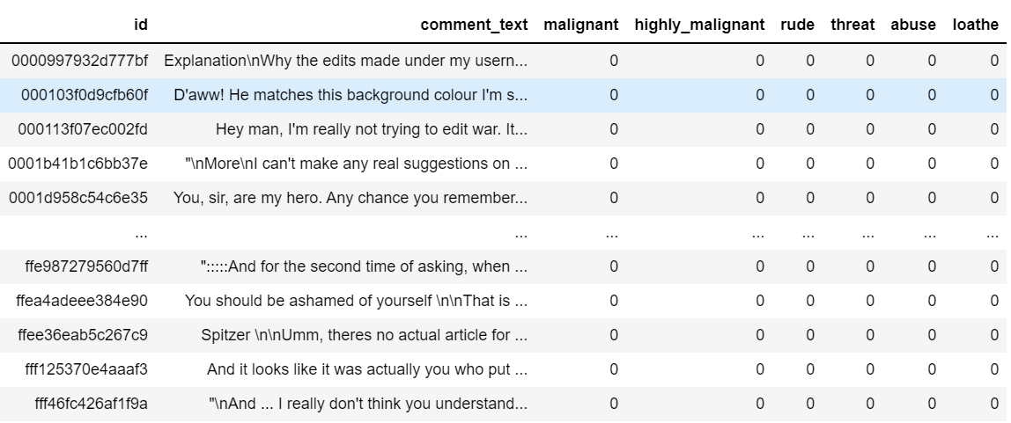
OBJECTIVE
Online forums and social media platforms have provided individuals with the means to put forward their thoughts and freely express their opinion on various issues and incidents. In some cases, these online comments contain explicit/ malignant language which may hurt the readers. Comments containing explicit language can be classified into myriad categories such as ‘Malignant’, ‘Highly malignant’, ‘Rude’, ‘Threat’, ‘Abuse’ and ‘Loathe’. The threat of abuse and harassment means that many people stop expressing themselves and give up on seeking different opinions.

Slide 4
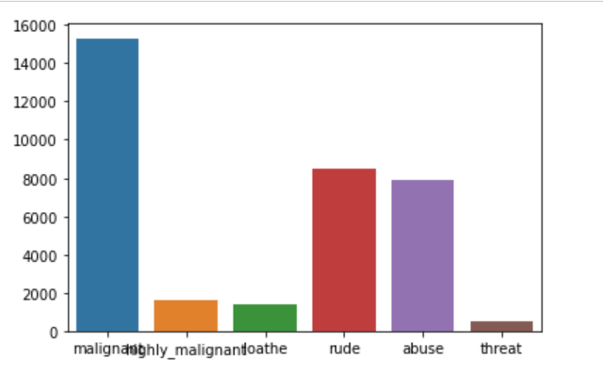
DATA VISUALIZATION / EDA
From this graph, we can analyse the density of labels present in train dataset. Here we can see that malignant comments are maximum than any other comments.

Slide 5
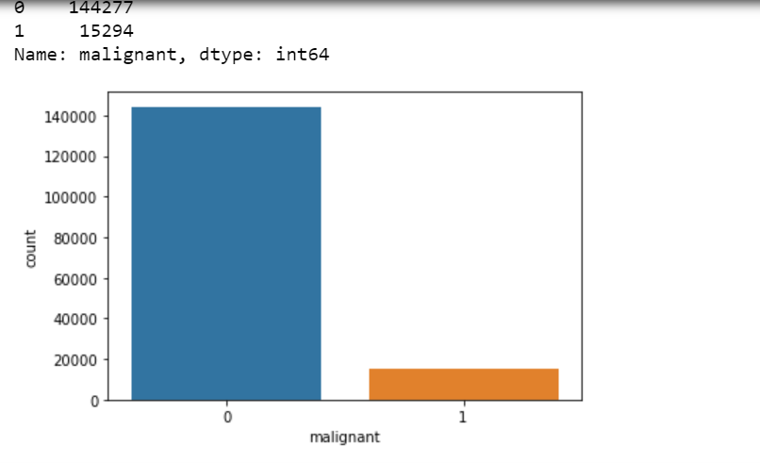
DATA VISUALIZATION / EDA
From train set distribution graph, we can say that most all labels (malignant, highly_malignant,
loathe, rude, abuse, threat) are highly negative(0). the count of malignant comments are less.

Slide 6
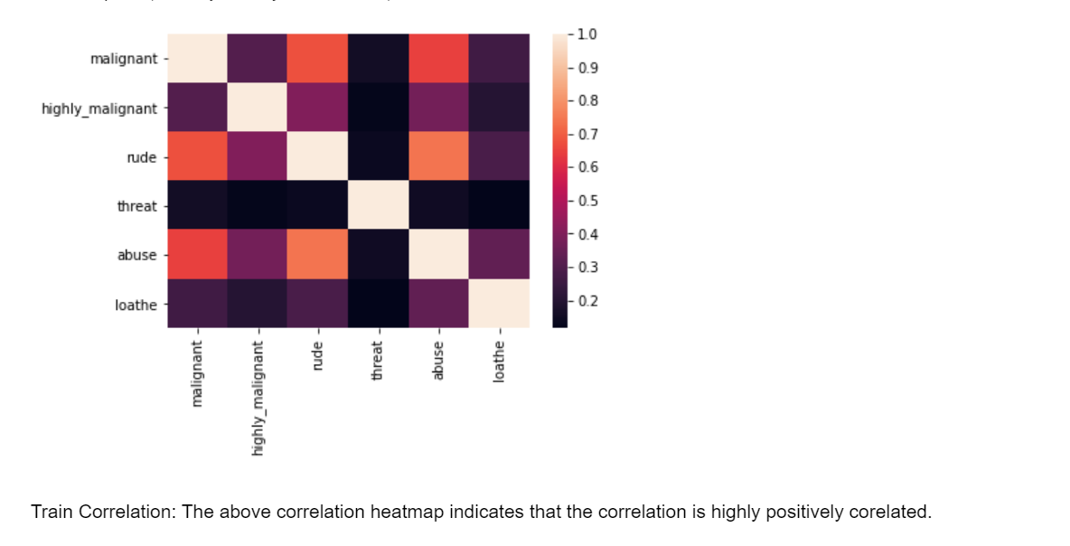
correlation

Slide 7
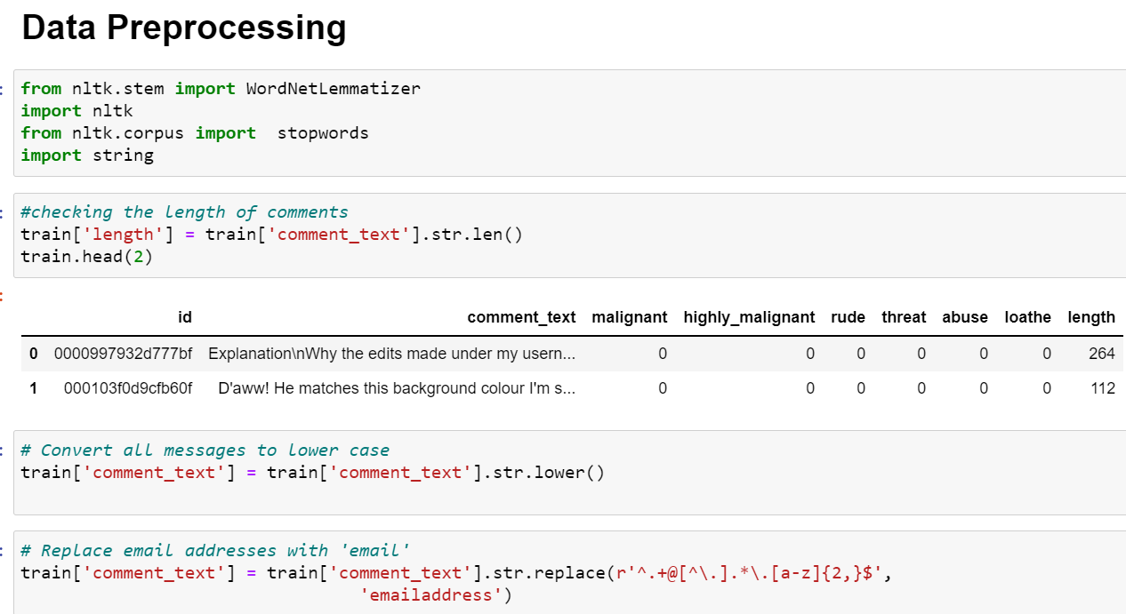
DATA PREPROCESSING
The text normalization steps that I performed are listed below:-
Removing Characters in between Text.
Removing Repeated Characters.
Converting data to lower-case.
Removing Punctuation.
Removing unnecessary white spaces in between words.
Removing “\n”.
Removing Non-English characters.

Slide 8
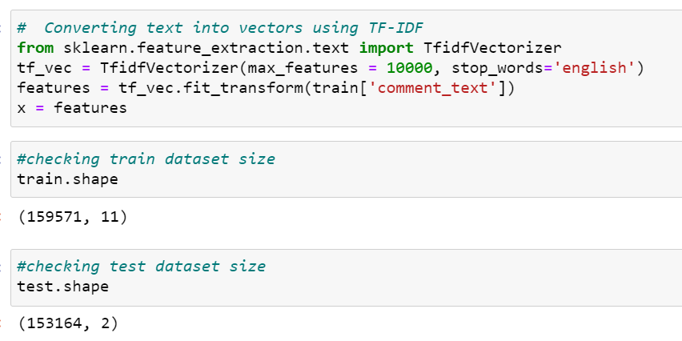

PREPROCESSING OF THE DATA
We have performed the following preprocessing on the data:
Removed punctuations
Removed the stop words
Stemming and lemmatization
Applied counter vectorizer

Slide 9
DATA MODELLING
Problem Transformation Method
We used the Logistic Regression classifier, Random Forest Classifier, Decision Tree Classifier, Ada Boost Classifier for classification.
We used this classifier, since it is suitable for classification with discrete features.
The algorithm estimates the conditional probability of a particular word given a class as the relative frequency of term t in documents belonging to class(c).
The variation takes into account the number of occurrences of term t in training documents from class (c),including multiple occurrences.

Slide 10
DATA MODELLING
Classification Algorithms
We used the Logistic Regression Classifier, Random Forest Classifier, Ada Boost Classifier, Decision Tree Classifier.
This project allowed me to work with two different deep learning models and additionally, I was able to implement them on a Natural Language Processing use-case.
Logistic Regression Classifier - we are getting training & testing accuracy of 96%
Random Forest Classifier - we are getting training accuracy of 99% and testing accuracy of 95%
Decision Tree Classifier - we are getting training accuracy of 99% & testing accuracy of 94%
Ada Boost Classifier, we are getting training accuracy of 95% & testing accuracy of 94%

Slide 11

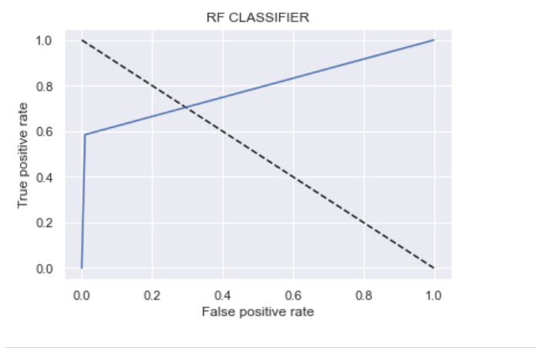
ANALYSIS OF RESULTS
After performing all models on this malignant comments, we found out that from all performed classifier models Random Forest Classifier seems to be best model. This gives us a fairly decent idea about the quality of our deep-learning model, and whether it has been appropriately trained.

Slide 12
CONCLUSION
Multiple labels – For Binary classification we have many models available but for multilabel classification the selection of models decreases drastically.
The data set contains the training set, which has approximately 1,59,000 samples and the test set which contains nearly 1,53,000 samples. This project data has been extracted from social media sites.
Cleaning the data - First and foremost, after importing the training and test data into the panda’s data frame, I decided to to clean the downloaded data and going ahead will opt for more functions to use.
The data set for building the classification model was acquired from the competition site and it included the training set as well as the test set. The steps elaborated in the workflow below will describe the entire process from Data Pre-Processing to Model Testing..

Slide 13
FUTURE SCOPE
The current project predicts the type or toxicity in the comment.
We are planning to add the following features in the future:
I got introduced to the concepts of word embedding and the advantages of using pre-trained word embedding also required to learn more to get better knowledge.
The motivating principle behind our project is promoting nonmaleficence within online communities by identifying harmful comments and acting against them. This is primarily experienced by those who prefer a safe and productive environment without negative distractions.

Slide 14
THANK YOU

